Slide 1


Counting and Basics of Probability

Slide 2

Permutations
A permutation is an act of arranging the objects or numbers in order.
The formula for permutations is: $=\frac{n!}{\left(n−r)!\right.}$
Example: How many different signals can be made by 5 flags from 8 flags of different colours?

Slide 3

Combinations Combinations are the way of selecting the objects or numbers from a group of objects or collection, in such a way that the order of the objects does not matter.
The formula for combinations is: $=\frac{n!}{r!(n−r)!}$
Example: How many poker hands of five cards dealt from a standard deck of 52 cards?

Slide 4
Counting Principles –
There are two basic counting principles, sum rule and product rule.
Sum Rule – If a task can be done in one of $n_{1}$ ways or one of $n_{2}$ ways, where none of the set of $n_{1}$ ways is the same as any of the set of $n_{2}$ways, then there are $n_{1}$+$n_{2}$ ways to do the task.
Example: No. of ways to order a dish from 5 veg dishes and 6 non-veg dishes is (5+6) ways = 11 ways
.

Slide 5
Example – In how many ways can a person choose a project from three lists of projects of sizes 10, 15, and 19 respectively?

Slide 6
Product Rule – If a task can be broken down into a sequence of k subtasks, where each subtask can be performed in $n_{1},n_{2},...,n_{k}$respectively, then the total number of ways the task can be performed is $n_{1}.n_{2}...n_{k}$ .

Slide 7
Example – In how many ways can 3 winning prizes be given to the top 3 players in a game played by 12 players?

Slide 8
Example 3 – How many distinct license plates are possible in the given format- Two alphabets in uppercase, followed by two digits then a hyphen and finally four digits. Sample- AB12-3456.

Slide 9
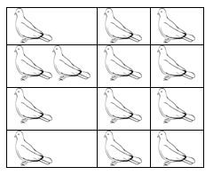
Pigeonhole Principle
Suppose that a flock of 20 pigeons flies into a set of 19 pigeonholes to roost. Because there are 20 pigeons but only 19 pigeonholes, a least one of these 19 pigeonholes must have at least two pigeons in it.
A general principle called the pigeonhole principle, which states that if there are more pigeons than pigeonholes, then there must be at least one pigeonhole with at least two pigeons in it.

Slide 10
Example – 1: How many students must be in a class to guarantee that at least two student receive the same score on final exam, if the exam is graded on a scale from 0 to 100 points?

Slide 11
Example – 2: A bag contains 10 red marbles, 10 white marbles, and 10 blue marbles. What is the minimum no. of marbles you have to choose randomly from the bag to ensure that we get 4 marbles of same color?

Slide 12
GATE-CS-2000
The minimum number of cards to be dealt from an arbitrarily shuffled deck of 52 cards to guarantee that three cards are from some same suit is (A) 3 (B) 8 (C) 9 (D) 12
Answer: (C)

Slide 13
Example: How many cards must be selected from a standard deck of 52 cards to guarantee that at least three hearts are selected?

Slide 14
Permutations with repetition –
Counting permutations when repetition of elements can be easily done using the product rule.
Example, number of strings of length r is ${26}^{r}$ since for every character there are 26 possibilities.
The number of r -permutations of a set of n objects with repetition is $n^{r}$ .

Slide 15
Example – How many three digit numbers can be formed from 2, 3, 4 , 5 and 0 if repetition is allowed if
There are no restrictions
The number is odd

Slide 16
Combinations with repetition –
Counting the number of combinations with repetition is a bit more complicated than counting permutations.
Consider a set of n types of objects.
No. of ways can r elements be chosen from n types of objects = $\left(\begin{matrix}n+r−1 \\ r\end{matrix}\right)$

Slide 17
Example – In how many ways can 4 drinks can be chosen out of 6 possible types of drinks? There is no restriction on the number of drinks of a type that can be chosen and drinks of the same type are indistinguishable.
Solution – The above scenario is a direct application of finding combinations with repetition.
So the number of 4-combinations is = $\left(\begin{matrix}6+4−1 \\ 4\end{matrix}\right)=\text{= }\left(\begin{matrix}9 \\ 4\end{matrix}\right)=126$

Slide 18
Example: A man wants to buy some pet birds. The pet store sells parrots, sparrows and pigeons. How many different selections are possible if the man wants to take 7 birds.

Slide 19
Determine the number of ways to choose 3 tea bags to put into the teapot. You have 100 each of these six types of tea: Black tea, Chamomile, Earl Grey, Green, Jasmine and Rose.

Slide 20

Binomial Theorem
Let x and y be variables and n be a non-negative integer. Then

Slide 21
Binomial Coefficients –
The r - combinations from a set of n elements ,denoted by $\left(\begin{matrix}n \\ r\end{matrix}\right)$ .
This number is also called a binomial coefficient since it occurs as a coefficient in the expansion of powers of binomial expressions.
The binomial theorem gives a power of a binomial expression as a sum of terms involving binomial coefficients.

Slide 22



Slide 23
Inclusion – Exclusion Principle

Slide 24
How many numbers between 1 and 1000, including both, are divisible by 3 or 4?

Slide 25
Aishwarya studies either computer science or mathematics everyday. If she studies computer science on a day, then the probability that she studies mathematics the next day is 0.6. If she studies mathematics on a day, then the probability that she studies computer science the next day is 0.4. Given that Aishwarya studies computer science on Monday, what is the probability that she studies computer science on Wednesday? (A) 0.24 (B) 0.36 (C) 0.4 (D) 0.6
Answer: (C)

Slide 26
Similarily for 3 finite sets $A_{1}$ , $A_{2}$ and $A_{3}$

Slide 27
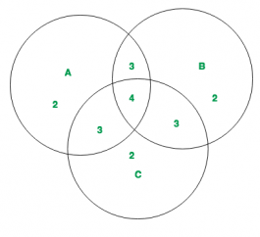
Example : As shown in the diagram, 3 finite sets A, B and C with their corresponding values are given. Compute

Slide 28
A large software development company employs 100 computer programmers. Of them, 45 are proficient in Java, 30 in C#, 20 in Python, six in C# and Java, one in Java and Python, five in C# and Python, and just one programmer is proficient in all three languages above.
Determine the number of computer programmers that are not proficient in any of these three languages.
Answer: 16

Slide 29
Principle :
Inclusion-Exclusion principle says that for any number of finite sets $A_{1}$, $A_{2}$, $A_{3}$,…, $A_{n}$.
Union of the sets is given by = Sum of sizes of all single sets – Sum of all 2-set intersections + Sum of all the 3-set intersections – Sum of all 4-set intersections + …+ ${\left(−1\right)}^{i+1}$ Sum of all the i-set intersections.
In general it can be said that,

Slide 30
Basics of Probability

Slide 31
Random Experiment
An experiment is random if although it is repeated in the same manner every time, can result in different outcomes:
The set of all possible outcomes is completely determined before carrying it out.
Before we carry it out, we cannot predict its outcome.
The sample space is the set of all possible outcomes of a random experiment
An event is a subset of the sample space (any set of outcomes of the random experiment).

Slide 32
Examples of Random Experiment
Tossing a coin
Rolling a dice
Picking an object
Tossing two coin simultaneously
Rolling two dice simultaneously

Slide 33
Example
Rolling a dice
Let A be the event that the outcome is divisible by 3
Let B be the event that outcome is an even number
Let C be the event that outcome is an odd number

Slide 34
Probability
Probability refers to the extent of occurrence of events. When an event occurs like throwing a ball, picking a card from deck, etc ., then the must be some probability associated with that event.
Probability of an Event – If there are total p possible outcomes associated with a random experiment and q of them are favourable outcomes to the event A, then the probability of event A is denoted by P(A) and is given by
P(A) = q/p

Slide 35
The probability of non occurrence of event A, i.e, P(A’) = 1 – P(A)
Note –
If the value of P(A) = 1, then event A is called sure event .
If the value of P(A) = 0, then event A is called impossible event.
Also, P(A) + P(A’) = 1

Slide 36
Four fair coins are tossed simultaneously. The probability that at least one head and one tail turn up is : (A) 1/16 (B) 1/8 (C) 7/8 (D) 15/16
Answer: (C)

Slide 37
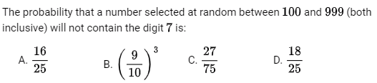
Answer: D

Slide 38
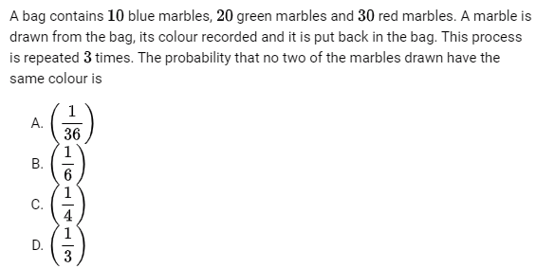
Answer: B

Slide 39


Answer: 35/66

Slide 40
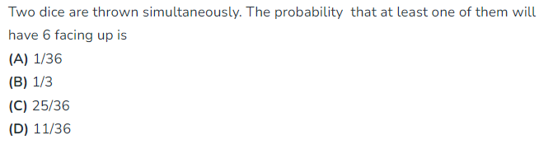
Answer: D

Slide 41
There are 3 red socks, 4 green socks and 3 blue socks. You choose 2 socks. The probability that they are of the same color is
1/5
7/30
¼
4/15
Answer: D

Slide 42
Theorems:
Let A, B, C are the events associated with a random experiment, then
P(A∪B) = P(A) + P(B) – P(A∩B)
P(A∪B) = P(A) + P(B) if A and B are mutually exclusive
P(A∪B∪C) = P(A) + P(B) + P(C) – P(A∩B) – P(B∩C)- P(C∩A) + P(A∩B∩C)
P(A∩B’) = P(A) – P(A∩B)
P(A’∩B) = P(B) – P(A∩B)

Slide 43
Example: 500 students are taking one or more courses out of chemistry, physics and mathematics. Registration records indicate course enrolment as follows: chemistry (329), physics (186), mathematics (295), chemistry and physics (83), chemistry and mathematics (217), and physics and mathematics (63), How many students are taking all 3 subjects?
37
43
47
53
Answer (d)

Slide 44
Example-: The probability that a person will get an electric contract is 2/5 and probability that he will not get plumbing contract is 4/7 . If the probability of getting at least one contact is 2/3, what is the probability of getting both ?

Slide 45

Answer: 10/12

Slide 46
Different Types of Events
Mutually Exclusive Events
Exhaustive Events
Equally Likely Events
Independent Events
Dependent Events

Slide 47
Mutually Exclusive Events – Two or more events associated with a random event are said to be mutually exclusive events if any one of the event occurrs, it prevents the occurrence of all other events.
This means that no two or more events can occur simultaneously at the same time.
i.e., $E_{1}∩E_{2}=φ$ then $E_{1} and E_{2}$ are mutually exclusive events.
Exhaustive Events – Two or more events associated with a random event are said to be exhaustive events if their union is the sample space.

Slide 48
EXAMPLE:
A sample space is given
Sample space = S = {1, 2, 3, 4, 5, 6, 7, 8, 9, 10}
Let an event X = {1, 2, 3}
Event Y = {4, 5, 6}
Event Z = {7, 8, 9, 10}
Solution:
Event X, Y, Z are mutually exclusive events because;
$$X∩Y∩Z=φ$$
For this, take the union of all events;
$X∪Y∪Z$= {1, 2, 3} $∪$ {4, 5, 6} $∪$ {7, 8, 9, 10} = {1, 2, 3, 4, 5, 6, 7, 8, 9, 10} = S
Event X, Y & Z are exhaustive events, because they form a complete sample space itself.

Slide 49
Example If A, B, C are three mutually exclusive and exhaustive events of an experiment such that 3P(A) = 2P(B) = P(C), then P(A) is equal to
Answer: 2/11

Slide 50
Equally likely events are events that have the same theoretical probability (or likelihood) of occurring
Example
Each numeral on a die is equally likely to occur when the die is tossed.
Sample space of throwing a die: { 1, 2, 3, 4, 5, 6 }

Slide 51
Independent events are those events whose occurrence is not dependent on any other event.
For example, if we flip a coin in the air and get the outcome as Head, then again if we flip the coin but this time we get the outcome as Tail.

Slide 52
Dependent events are those events whose occurrence is dependent on any other event.
For example, if we roll two dice simultaneously.
A : 3 on first dice
B : sum on two dice is 7

Slide 53
If A and B are independent events such that 0 < P (A) < 1 and 0 < P (B) < 1, then which of the following is not correct?
A and B are mutually exclusive
A and B′ are independent
A′ and B are independent
A′ and B′ are independent
Answer(A)

Slide 54
Let S be the sample space and two mutually exclusive events A and B be such that A U B = S. If P(.) denotes the probability of the event. The maximum value of P(A)P(B) is ______ (A) 0.5 (B) 0.25 (C) 0.225 (D) 0.125
Answer: (B)

Slide 55
GATE DA 2024
How many 4-digit positive integers divisible by 3 can be formed using only the digits {1, 3,4, 6, 7}, such that no digit appears more than once in a number?
24
48
72
12
Answer: (B)

Slide 56
GATE DA 2024
The probability of a boy or a girl being born is 1/2. For a family having only three children, what is the probability of having two girls and one boy?
3/8
1/8
1/4
1/2
Answer: (A)

Slide 57
GATE DA 2024
Three fair coins are tossed independently. T is the event that two or more tosses result in heads. S is the event that two or more tosses result in tails. What is the probability of the event 𝑇 ∩ 𝑆 ?
0
0.5
0.25
1
Answer: (A)

Slide 58
GATE DA 2024 (Sample paper)
A fair coin is flipped twice and it is known that at least one tail is observed. The probability of getting two tails is
1/2
1/3
2/3
1/4
Answer: (B)

Slide 59

Thank you

Slide 60
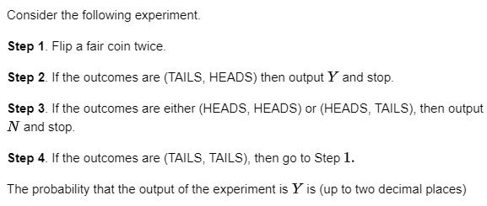
Answer: (0.33)

Slide 61
Two people, 𝑃 and 𝑄, decide to independently roll two identical dice, each with 6 faces, numbered 1 to 6. The person with the lower number wins. In case of a tie, they roll the dice repeatedly until there is no tie. Define a trial as a throw of the dice by 𝑃 and 𝑄. Assume that all 6 numbers on each dice are equi-probable and that all trials are independent. The probability (rounded to 3 decimal places) that one of them wins on the third trial is ____
Answer: 5/216

